Slide 1
International Comparison Program
Views from Japan as a participating country
国際比較プログラム
参加国としての日本からの視点
April 22, 2017
2017 SNA Study Group Seminar
at Senshu University, Kanda, Tokyo, Japan
2017年度第1回国民経済計算研究会
於：専修大学神田校舎1号館
Nihon University
College of Economics
Shigeru Kawasaki
Ministry of Internal Affairs and Coordination
Naoki Makita

Slide 2
Contents
Introduction
Highlights of the ICP Results
Data for OECD Comparison
ICP Data Provided from Japan
Conclusion

Slide 3
1. Introduction
Context
The ICP is a large-scale global statistical undertaking based on close collaboration of theorists and practitioners.
Limitations in resources and data availability resources have been obstacles to development of the ICP.
It is important to discuss the ICP from both theoretical and practical viewpoints.
Aims of the presentation
To promote understanding on the ICP, especially from the viewpoints of usefulness of results, efforts of data collection.
To discuss the challenges ahead for the ICP
Main Messages
The ICP results are valuable. Let’s make best use.
Understand better the merits and limitations of the ICP results
Give support and suggestions to development of the international comparisons

Slide 4
2. Highlights of the ICP Results
The ICP results give us excellent perspectives of the world economy.
How does the Japanese Economy look from the ICP in contrast with the exchange rate based comparisons? → See some highlights of the ICP Results
Eurostat-OECD Comparisons (2008-2014)
ICP World Comparisons (2011).
ICP World Comparisons
Research Phases
Operational Phases
Phase I
II
III
Phase IV
V
VI
ICP 2005
ICP 2011
1970
73
75
1980
85
93
2005
11
Eurostat-OECD Comparisons
1980
85
90
93
96
99
2002
05
08
11
14
The slides in Section 2 are based on the data from following data sources:
“OECD.Stat” (OECD Statistics Directorate) http://stats.oecd.org/Index.aspx?DataSetCode=PPP2014#
“International Comparison Program (ICP) – ICP 2011” (World Bank) http://www.worldbank.org/en/programs/icp#5

Slide 5
2. Highlights of the ICP Results
(1-1) Total GDP in Exchange Rate and PPP - OECD Comparison (2014)
GDP (2014) in Exchange Rate
and Current PPP
Exchange-rate based
PPP based
PPP ranking lower than exchange rate ranking
Rankings and relative sizes do not change very much in the two cases, except high price countries (e.g. UK, Canada) and low price countries (Mexico, Turkey).

Slide 6
2. Highlights of the ICP Results
(1-2) GDP per capita in Exchange Rate and PPP - OECD Comparison (2014)
GDP per capita (2014)
in Exchange Rate and Current PPP
Exchange-rate based
PPP based
PPP ranking lower than exchange rate ranking
High income countries have relatively lower PPP-based GDP per capita than exchange-rate-based, i.e. price levels of rich countries are higher.

Slide 7
2. Highlights of the ICP Results
(1-3) Time Series of GDP per capita - OECD Comparison (2014)
Japan’s GDP per capita in Exchange Rate and PPP
OECD Comparison (2008-2015)
Depreciation of Yen
Appreciation of Yen
Exchange-rate-based GDP is volatile in reaction to currency fluctuation, while PPP-based GDP shows more stable growth. Movement of the exchange-rate-based GDP is often misleading.

Slide 8
2. Highlights of the ICP Results
(1-4) Price Level in Time Series (GDP Level) - OECD Comparison (2014)
Price Levels for GDP (USA=100) of selected countries
Switzerland
Germany
Japan
Denmark
USA
Mexico
Changes in relative price levels reflect the changes in the exchange rates and the inflation rates.
Japan’s price level is most volatile among countries due to currency fluctuations. From 2015, most countries’ relative price levels are declining due to appreciation of US$.

Slide 9
2. Highlights of the ICP Results
(1-5) Price Levels by Expenditure Category - OECD Comparison (2014)
Japan and USA (OECD=100)
Japan and Switzerland (OECD=100)
Japan
Japan
USA
Switzerland
Japan’s price levels are higher than OECD average for Food & Drinks and Communication, while lower for Health and Education.
US price levels are higher than OECD average for Health and Education, while lower for Food and Transport.
Swiss price levels are higher than OECD average for all expenditure categories, and especially high for Housing, Health and Education.

Slide 10
2. Highlights of the ICP Results
(2-1) Total GDP and per capita, Exchange Rate and PPP – ICP 2011 Comparison
Total GDP
GDP per capita
In the World Comparison, gaps between exchange-
rate and PPP based GDP are wider than in the OECD Comparison, because income levels are more diverse in the World Comparison.
For global comparison of GDP among countries, PPP based statistics play particularly important roles.
Exchange-rate based
PPP based
Exchange-rate based
PPP based

Slide 11
2. Highlights of the ICP Results
(2-2) Relationship of Income and Price Levels (2011) – ICP 2011 Comparison
GDP per capita in PPP (Linear Scale)
and Price Level
GDP per capita in PPP (Log Scale)
and Price Level
$
GDP per capita and price levels are positively correlated.
OECD countries have a good fit of regression, but not so for non-OECD countries.
Non-OECD countries are diverse in terms of income level and structure of domestic market. For example, oil-producing countries have high incomes, but their domestic prices are at a similar level to other developing countries.

Slide 12
2. Highlights of the ICP Results
(2-3) Price Levels by Expenditure Category – ICP 2011 Comparison
Japan, USA and Switzerland (World=100)
Japan, China and India (World=100)
Japan
Japan
China
India
USA
Switzerland
In 2011, Japan’s price levels were higher than the US, but lower than Switzerland. Relative price levels among expenditure categories are similar to those of 2014, e.g. lower prices for Health and Education, higher prices for Food and Drinks.
With China and India, Japans price levels are much higher than China and India. The gap of price levels for Machinery and Equipment were the smallest among expenditure categories.

Slide 13
Supplement Earlier ICP Results
 |  | 1970 | 1975 | 2008 | 2014
Exchange Rate (\/$) |  | 360 | 297 | 103 | 106
PPP (\/$) | GDP Price Level (USA=100) | 244 (67.8) | 271 (91.2) | 117 (113.6) | 102 (96.2)
 | Indiv. Consumption | 233 | 271 | 119 | 101
 | Food, beverage & tobacco | 339 | 317 | 200 | 166
 | Capital Formation | 286 | 299 | 121 | 113
 | Government | 215 | 323 | 87 | 77
Per capita GDP $ (Ex) (Relative to USA) |  | 2,003 (41.7%) | 4,474 (62.3%) | 39,345 (81.4%) | 38,143 (70.0%)
Per capita GDP $ (PPP) (Relative to USA) |  | 2,952 (58.5%) | 4,907 (68.4%) | 34,804 (72.0%) | 38,371 (72.4%)
Source: 1970: I.B. Kravis et. al. “A system of international comparisons of gross product and purchasing power parities”
1975: I.B.Kravis et.al. “World Product and Income – International Comparisons of Real Gross Product”
2008, 2014: OECD Statistics Directorate: OECD.Stat http://stats.oecd.org/Index.aspx?DataSetCode=PPP2014

Slide 14
3. Data for OECD Comparison
(1) Schemes of the World Comparison and the Regional Comparisons
Scheme of World Comparison
2011
Eurostat-OECD Comparison
2011, 2014
ICP 2011
199 Countries
Africa
50
CIS
23
EU-OECD
47
Latin America
17
Carib-
bean
22
West.
Asia
12
Pacific
Is.
50
Note: The sum of the numbers in regional groups are not equal to the number in the World Comparison due to dual and single participants.
Source: World Bank “Purchasing Power Parities and the Real Size of World Economies” P.3
Source: OECD, Eurostat, “Eurostat-OECD Methodological Manual on Purchasing Power Parities” P.59

Slide 15
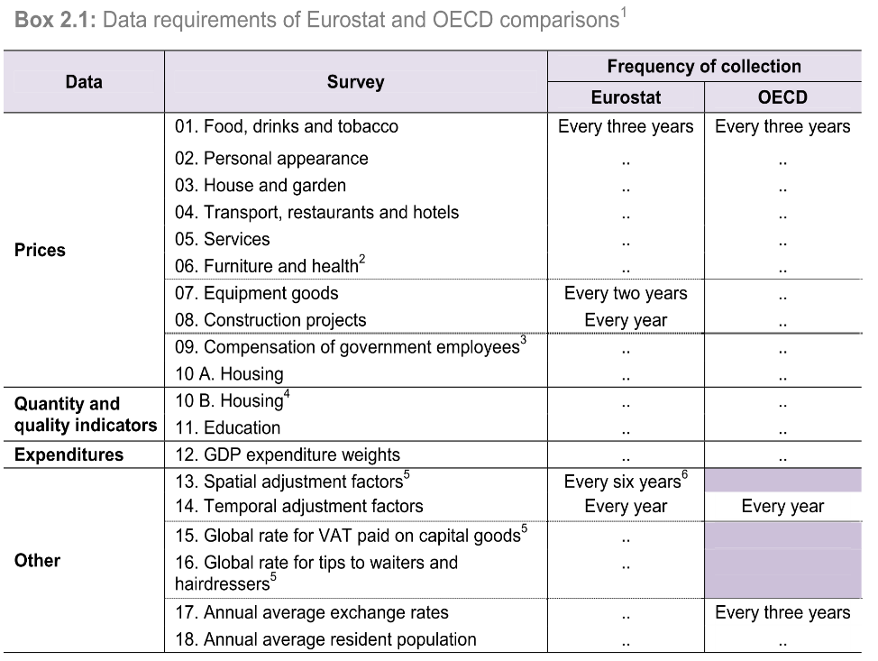
3. Data for OECD Comparison
(2) Data Required in the Eurostat-OECD Comparison
The ICP aims to decompose GDP into price and volume.
Value = Price X Volume
Eurostat- OECD Comparison requirements are grouped into the following:
1. Expenditure data for GDP
2. Price data
3. Quantity data
4. Other special data
Prices are obtained from retail surveys or other similar surveys. Expenditure are obtained by reclassifying the national accounts data.
Quantity data for education is collected and processed directly by OECD using exist- ing international sources.
Japan not applicable
Japan not applicable
Source: OECD, Eurostat “Eurostat-OECD Methodological Manual on Purchasing Power Parities” P.50

Slide 16
3. Data for OECD Comparison
(3) Classification of Expenditure on GDP (2014 Eurostat-OECD)
The participating countries provide the ICP with GDP expenditure broken down into 189 basic headings, which is far more detailed than officially published SNA tables.
The intermediate levels of classification are called:
Categories (13),
Groups (44),
Classes (105).
OECD results are published at the category level. For “01 Food and non-alcoholic beverages”, data of group and class levels are also published.
Source: OECD, Eurostat, unpublished document for data collection

Slide 17
4. ICP Data Provided from Japan
(1) Compilation of Data of Japan
Data |  | Compiling Agency
Expenditure on GDP |  | Cabinet Office (Economic and Social Research Institute) (ESRI)
Prices and Quantities | Consumer Goods and Services | Statistic Bureau, Ministry of Internal Affairs and Communication (MIC)
 | Housing (Rent) | Statistic Bureau, MIC
 | Hospital Services | Ministry of Health, Labor and Welfare (MHLW)
 | Government Salaries | Statistical Standards, MIC
 | Construction | Ministry of Land, Infrastructure, Transport and Tourism (MLIT)
 | Machinery and Equipment | Ministry of Economy, Trade and Industry (METI)
To meet the requirements of the ICP for a broad range of data, data compilation in the Government is coordinated by the Director-General for Statistical Standards in collaboration with various ministries.
Expenditure data is compiled by the Cabinet Office which is responsible for national accounts statistics. Prices and quantities are compiled by several agencies. For household consumption, the Statistics Bureau compiles most of the statistics. Prices for capital formation and government are compiled by several specialized agencies.
Source: Director-General for Statistical Standards, MIC

Slide 18
4. ICP Data Provided from Japan
(2) GDP Expenditure
For the detailed breakdown of GDP Expenditure, the official SNA tables give only 12 categories of expenditure for households, 2 categories for NPISHs, and no breakdown for the General Government.
The government final consumption is classified by individual and collective con- sumptions, but breakdown by purposes of expenditure is not readily available.
To meet the requirements of the ICP, the Cabinet Office collected supplementary data to estimate the detailed breakdowns.
The list continues …

Slide 19
4. ICP Data Provided from Japan
(3) Prices of Individual Consumption by Households
Category | Number of prices
 | Requested by OECD | Provided from Japan
Food & non-alcoholic beverages | 378 | 228
Clothing and personal effects | 304 | 260
Household goods | 359 | 261
Transport, restaurants, hotels | 214 | 163
Services | 159 | 101
Furniture, medicine^{(*)} | 148 | 126
Total | 1,562 | 1,139
Prices of household consump- tion were collected by the Statistics Bureau.
The ICP requested to provide prices of up to 1,562 items in the specification list.
Out of the list, Japan provided 1,139 prices, of which 6 percent was taken from the Retail Price Survey regularly conducted for the CPI and remaining 94 percent were obtained from special price surveys.
The list represents European consumption patterns. Products commonly consumed in Japan are not well reflected.
e.g. Cheese, Fish, Noodles, Wine
Note: “Medicine” here covers only those sold in drug stores, and excludes those provided by health insurance.

Slide 20
4. ICP Data Provided from Japan
(4) Housing (Rent)
Rent data were provided by the Statistics Bureau, MIC. They were estimated from the Housing and Survey 2013.
The OECD requested countries to provide monthly rent, average surface (floor) area, and number of dwellings for each of 17 types of dwellings for Japan, Korea, and the EU. For the rest of OECD countries (e.g. USA, Canada, Australia, New Zealand, etc.), another set of 17 types was provided. The list of dwelling types covered both actual rents (i.e. rented dwelling) and imputed rents (i.e. owner-occupied dwellings).
Life styles are diverse among countries. Information for quality adjustment is quite limited.
Types of Dwellings (Rented)
Types of Dwellings (Owner-Occupied)
N° | Flat/ House | Rooms | Central heating
1 | Flat | 1-2 | No
2 | Flat | 1-2 | Yes
3 | Flat | 3 | No
4 | Flat | 3 | Yes
5 | Flat | >=4 | No
6 | Flat | >=4 | Yes
7 | House | All | No
8 | House | All | Yes
N° | Flat/ House | Rooms | Central heating
10 | Flat | 1-2 | No
11 | Flat | 1-2 | Yes
12 | Flat | 3 | No
13 | Flat | 3 | Yes
14 | Flat | >=4 | No
15 | Flat | >=4 | Yes
16 | House | All | No
17 | House | All | Yes

Slide 21
4. ICP Data Provided from Japan
(5) Hospitals PPP Services
Data for medical service prices were provided by the Ministry of Health, Labor, and Welfare. The data provided from Japan were mainly based on a special survey. The medical services in this field refer to those of acute medical cares provided by general and specialized hospitals.
The OECD requested countries to provide data and information in 5 tables listed below. Countries were to select a sample of hospitals from which prices of medical services could be collected. Countries are asked to provide background information of hospital services in addition to the medical service prices.
Table 1 Characteristics of the sample – Numbers of hospitals, cases and expenditure
Table 2 Characteristics of the sample hospitals – Number of cases and total expenditure
by type of services* – Medical/surgical, Inpatient/outpatient
Table 3 Number of cases and expenditure by type of care (stay/non-stay, medical/surgical)
Table 4 Quasi price*** adjustment
Table 5 Number of cases, quasi-price and average length of stay by case type
* Type of services: A list of 36 case types was provided for price collection. (cf. Supplement 3)
** Quasi price: Negotiated prices or administered prices of hospital services. For Japan, the latter applies. In principle, quasi prices to be collected should reflect the full set of cost for providing the services. The concept of quasi price complies with the System of Health Account.

Slide 22
4. ICP Data Provided from Japan
(6) Salaries of Government Employees
As input data for “Collective Consumption Expenditure of Government”, data on salaries of Government Employees for 7 medical occupations and 17 non-medical occupations were requested by the OECD. The request from the OECD comprised data on average annual gross salaries (basic pay and other payments), employers’ social contribution (actual and imputed), working time information (i.e. contractual working time, holiday entitlement, public holidays, etc.) for as many occupations (as defined in the International Standard Classification of Occupations = ISCO) as possible.
Collective services provided by government are normally provided free of charge or at prices that are not economically significant. For this reason, measurement of this expenditure is based on the cost of input rather than the value of the output. For this reason, the comparison of this category is based on the prices and the volumes of the input.
From Japan, MIC compiled the data from the Survey on Salaries of National Civil Servants and the Survey on Salaries of Civil Servants of Local Governments Japan, and provided data for 7 non-medical occupations. It was difficult to apply ISCO to administrative and clerical staff ISCO because most civil service jobs in Japan are not classified by occupations. Japan doesn’t provide data for occupations of medical staff because employees of national hospitals are deemed to be agency staff, not government official.

Slide 23
4. ICP Data Provided from Japan
(7) Construction Survey
Data for the Construction Survey were provided
by the Ministry of Land, Infrastructure, Transport
and Tourism.
The OECD requested participating countries to
provide cost estimates of at least 7 construction
and civil engineering projects out of 11 standards
projects (5 residential bldgs., 3 non-residential
buildings, 2 civil engineering. projects.) For each
project, a list of material and labor components
was provided (called “Bill of Quantities”).
Countries were to provide the unit prices for
each component, and provide estimates of the
total cost.
Japan provided cost estimates made from
interviews of construction companies and
hired consultants in the private sector.
List of Standard Projects
505-2. Detached house
505-2A. Portuguese single-family house
505-5. Nordic house
505-6. North American house
505-7. Japanese single-family house
505-4. Apartment
506-2. Factory Building
506.2J Japanese Factory Building
506-5N. Office building - New
507-1 Asphalt road
507-7 Bridge

Slide 24
4. ICP Data Provided from Japan
(8) Observations about the data collection in Japan
Data collection is a joint operation of 5 ministries, requiring large resources. Careful planning and coordination of data collection work is essential. Creating a unit dedicated for the ICP work in the Japanese government is desirable, although available resources are limited.
The lists of products for price collection reflect European markets, and products commonly available in Japan are not well reflected. Although there has been improvement recently, more efforts will be needed to achieve a better balance among different life styles and cultures.
(e.g. food in household consumption, housing, government services)
For the comparison of education, the OECD uses the data directly collected from international sources. The comparison is based on the volume of output (student-hours) adjusted for quality (scores of achievement exams). While the methods are explained in the manual, verifying the processes is difficult due to lack of details. Disclosure of more detailed information of process is desirable.

Slide 25
5. Conclusion
The ICP provides valuable data of volume measures of GDP and its expenditure breakdown for international economic analysis. Economic and social researchers working on international analyses should be encouraged to use the ICP results more extensively.
Reliability of the results is difficult to assess due to complexity and multitude of basic data. More extensive dissemination of background data will be needed.
The selection of products for comparison may be too strongly oriented towards western life style, and country preferences may not be well reflected. More efforts are needed to elaborate the list of products.
The OECD group is moving towards annual compilation. The workload of data collection is quite large for Japan. Cost and benefit of “annualization” should be considered more. It may be better to put higher priority to quality improvement of comparison rather than increase of frequency.
The ICP is a long term statistical project of global scale. The efforts should be continued by maintaining support from users.

Slide 26
The End
Thank you!
Reference:
A: 国際比較プログラム（ICP）への参加 (Participation of Japan in ICP) in Japanese)
http://www.soumu.go.jp/toukei_toukatsu/index/kokusai/icp.html
B: Prices and purchasing power parities (PPP) – Statistical Databases
http://www.oecd.org/std/prices-ppp/
C: International Comparison Program (ICP) – Documents and Data files
http://www.worldbank.org/en/programs/icp
D: OECD “Eurostat-OECD Methodological Manual on Purchasing Power Parities, 2012 Edition”
http://www.oecd.org/std/prices-ppp/eurostat-oecdmethodologicalmanualonpurchasingpowerparitiesppps.htm
E: World Bank Group “Purchasing Power Parities and the Real Size of World Economies - A COMPREHENSIVE REPORT OF THE 2011 INTERNATIONAL COMPARISON PROGRAM” 2015
http://siteresources.worldbank.org/ICPEXT/Resources/ICP_2011.html
Authors:
Shigeru Kawasaki, Professor, Nihon University College of Economics, Tokyo, Japan
Former Director-General of the Statistics Bureau, MIC, Japan
Naoki Makita, Director for International Statistics Affairs, Office of Director General for Policy Planning
on Statistical Standards, MIC, Japan

Slide 27
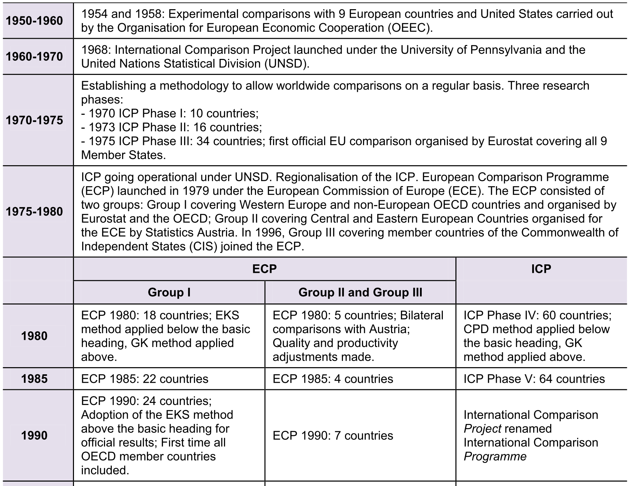
Annex 1 History of ICP (1/3)

Slide 28
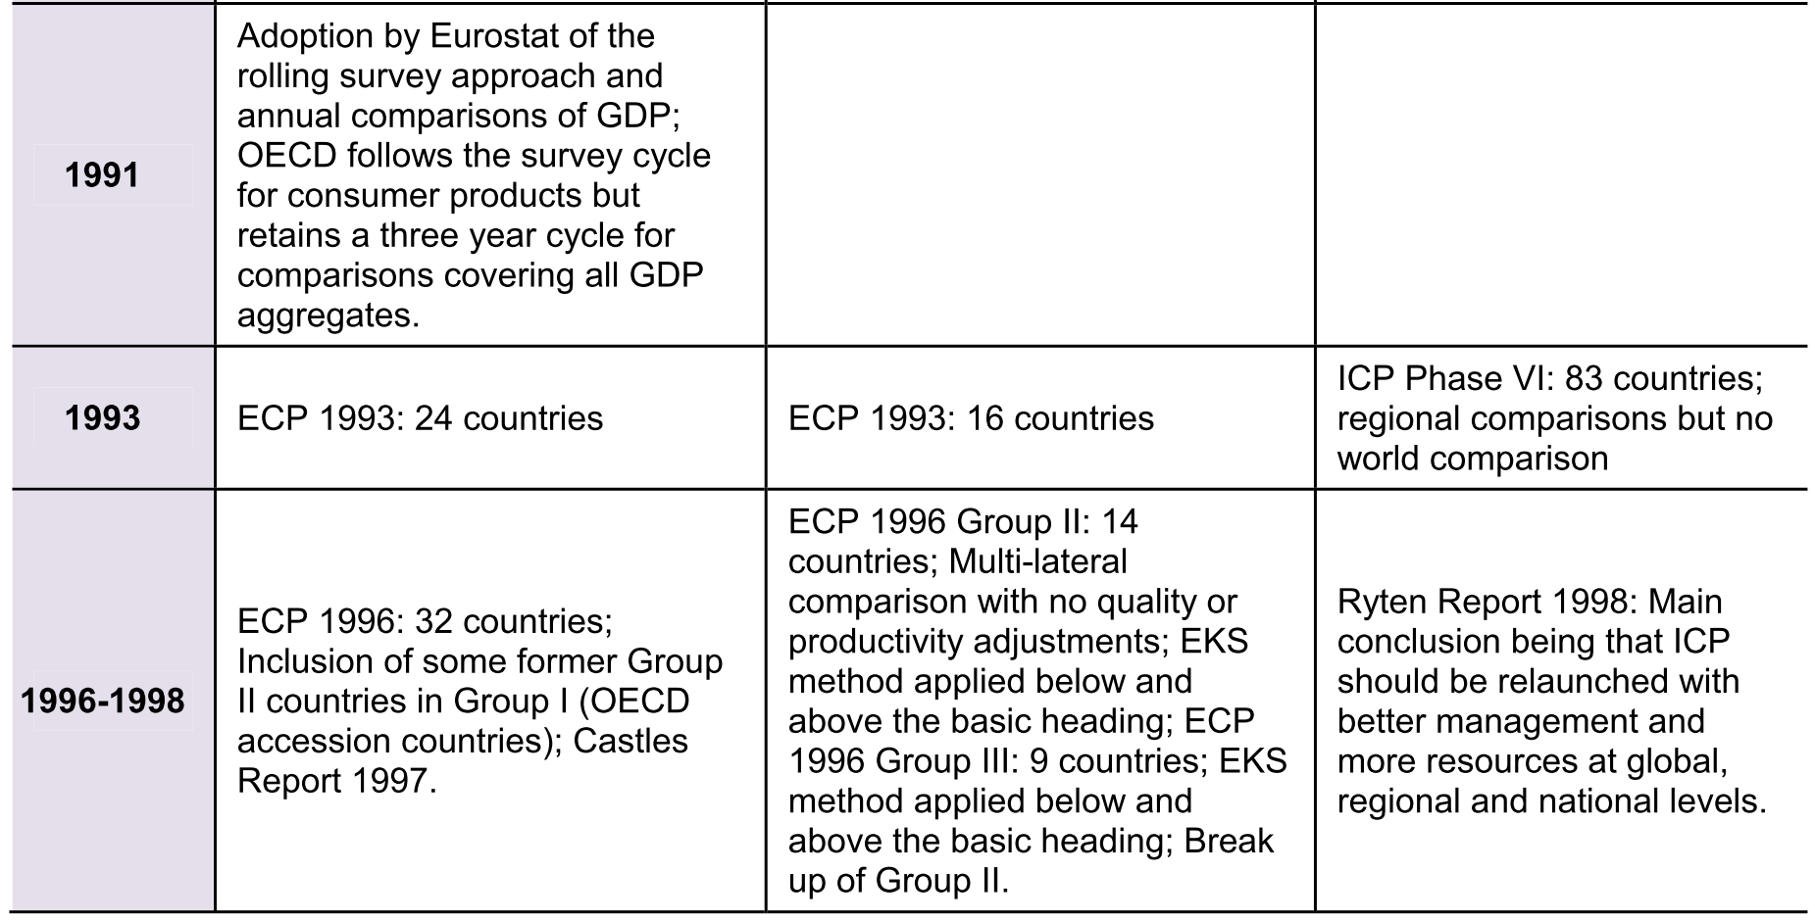
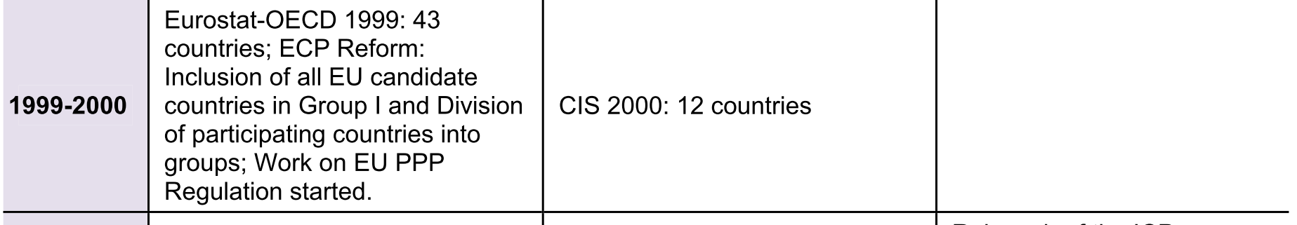
Annex 1 History of ICP (2/3)

Slide 29
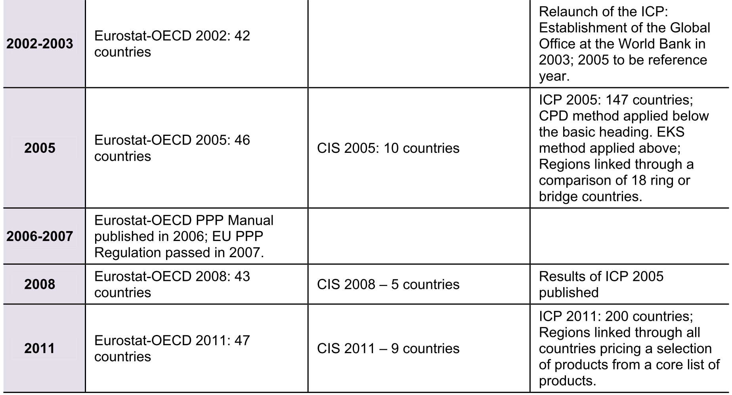
Annex 1 History of ICP (3/3)

Slide 30
Annex 2 Hospital Services
- Case Types
Medical Services - Inpatient typical cases
M01, Acute myocardial infarction
M02, Angina pectoris
M03, Cholelitiasis
M04, Heart failure
M05, Malignant neoplasm of bronchus and lung
M06, Normal delivery
M07, Pneumonia
M08, Chronic obstructive pulmonary disease
M09, Acute bronchitis/bronchiolitis
M10, Concussion
M11, Multiple sclerosis
Surgical Services - Inpatient typical cases
S01, Appendectomy
S02, Caesarean section
S03, Cholecystectomy
S04, Colorectal resection
S05, Coronary artery bypass graft
S06, Discectomy
S07, Endarterectomy: vessels of head and neck
S08, Hip replacement: total and partial
S09, Hysterectomy: abdominal and vaginal
S10, Knee replacement
S11, Mastectomy
S12, Open prostatectomy
S13, Percutaneous transluminal coronary angioplasty (PTCA)
S14, Peripheral vascular bypass
S15, Repair of inguinal hernia
S16, Thyroidectomy
S17, Transurethral resection of prostate (TURP)
S18, Arthroscopic excision of meniscus of knee
S19, Cataract surgery
S20, Ligation and stripping of varicose veins - lower limb
S21, Tonsillectomy and/or adenoidectomy
Surgical Services - Day surgery/outpatient surgery
S18, Arthroscopic excision of meniscus of knee
S19, Cataract surgery
S20, Ligation and stripping of varicose veins - lower limb
S21, Tonsillectomy and/or adenoidectomy

Slide 31
Annex 3 Salaries of Government Employees – Types of Job
Physicians
aa Hospital doctor
ab Specialist doctor
Nurses and other medical staff
aa Hospital nurse (skill lev.4)
ab Hospital nurse (skill lev.3)
ac Laboratory assistant
ad Nursing aide (clinic or hospital)
Non-medical staff
aa Executive official
ab Secretary
ac Cleaner
aa Judge
ab Law clerk
ac Police inspector
ad Police officer
ae Firefighter
af Prison guard
ba Statistician
bb Database administrator
bc Executive official
bd Customs inspector
be Tax officer
bf Computer operator
bg Secretary
bh Maintenance electrician
bi Driver
bj Building caretaker
bk Cleaner

Slide 32
Annex 4 Abbreviations
AIC Actual Individual Consumption
COICOP Classification of Individual Consumption According to Purpose
COFOG Classification of the Functions of Government
COPNI Classification of the Purposes of Non-Profit Institutions Serving Households
CPA Classification of Products by Activity
CPD Country Product Dummy (method)
CPI Consumer Price Index
ECP European Comparison Programme
EKS Èltetö-Köves-Szulc (method)
EKS-S Èltetö-Köves-Szulc-Sergeev (method)
ESA European System of
FTE Full-time equivalent
GDP Gross Domestic Product
GEKS Gini- Èltetö-Köves-Szulc (method)
GK Geary Khamis (method)
GFCF Gross Fixed Capital Formation
HICP Harmonised Index of Consumer Prices
ICP International Comparison Programme
ICD International Classification of Diseases
IMF International Monetary Fund
ISCED International Standard Classification of Education
ISCO International Standard Classifications of Occupations
NACE Nomenclature Générale des Activités Economiques dans les Communautés
NPISH Non-Profit Making Institution Serving Households
NSI National Statistics Institute
PLI Price Level Index
PPP Purchasing Power Parity
SNA 93 System of National Accounts 1993
SNA 2008 System of National Accounts 2008
SPD Structured Product Description
VAT Value Added Tax

